Slide 1
Biodiversity for the national parks
A Summary of Findings and Recommendations

Slide 2
Species Dataset
Key Insights into the Dataset from which our Study Began

Slide 3
Beginning Observations
The “species_info.csv” data set had limited information regarding its conservation status
The species ranged from animals to plants, each with a corresponding status
The common names of each species were essential for a non-scientist, like myself, to analyze the data

Slide 4
Species Breakdown
Category | Count
Amphibian | 79
Bird | 488
Fish | 125
Mammal | 176
Nonvascular Plant | 333
Reptile | 78
Vascular Plant | 4262
Conservation Status | Count
Endangered | 15
In Recovery | 4
No Intervention | 5363
Species of Concern | 151
Threatened | 10
Total Species: 5541

Slide 5
Endangered Species
The Significance between the Susceptibility of Endangerment amongst varying species

Slide 6
Protection of Species
Category | Protected | Not Protected
Amphibian | 7 | 72
Bird | 75 | 413
Fish | 11 | 115
Mammal | 30 | 146
Nonvascular Plant | 5 | 328
Reptile | 5 | 73
Vascular Plant | 46 | 4216

Slide 7
Significance of Endangerment
Category | % Protected | Difference* | Significant
Bird | 15.36% | ~0.687 | No
Reptile | 6.41% | ~0.038 | Yes
Fish | 8.73% | ~0.056 | No
Amphibian | 8.86% | ~0.127 | Yes
Nonvascular Plant | 1.50% | ~1.48-10 | Yes
Vascular Plant | 1.07% | ~1.44-55 | Yes
The “Mammal” category yielded the highest percentage of protection: 17.05%
Are mammal’s susceptibility for endangerment significantly different than other specie categories?
The chart to the left compares the mammal’s protection rate to others, checking for significant differences.
* Lower difference value reflects a higher significance

Slide 8
Endangered Species: Conclusion
Some species are more susceptible to endangerment than others.
Although the “Percent Protected” figure gives us an idea of a specie’s susceptibility to endangerment, comparing the species to find significant differences will allow us isolate which specie categories aren’t like the others.

Slide 9
Recommendation
Concerning Endangered Species

Slide 10
Recommendation for Conservationists
Focus attention and resources on the highest risk specie category (Mammal) and its similarly at risk categories (Bird, Fish)
Similarly Low Risk Categories
Similarly High Risk Categories
Category | % Protected | Difference* | Significant
Reptile | 6.41% | ~0.038 | Yes
Amphibian | 8.86% | ~0.127 | Yes
Nonvascular Plant | 1.50% | ~1.48-10 | Yes
Vascular Plant | 1.07% | ~1.44-55 | Yes
Category | % Protected | Difference | Significant
Mammal | 17.05% | N/A** | N/A
Bird | 15.36% | ~0.687 | No
Fish | 8.73% | ~0.056 | No
**Difference significance values are not available for “Mammals” since all other categories were compared to “Mammals”, therefore N/A

Slide 11
Recommendation Explanation
Although there was some various between each specie category, the significance test we ran helped us determine how different each category was compared to “Mammals”, the highest protected specie.
“Fish” and “Bird” species did not differ significantly from “Mammals”. Therefore, these are of similar priority and concern.
All other species differed significantly from “Mammals”, telling us that they are of less concern and susceptibility to endangerment.

Slide 12
Sample Size
Understanding for the “Foot and Mouth Disease” Study

Slide 13
Sample Size: Context
For the “Foot and Mouth Disease” study, we isolated Sheep species and the total number of observations in a 7 day period
Grouping this data by park yielded the chart on slide 15
In order to confidently detect reductions of the disease amongst our sample, we calculated the necessary size for our sample
We used the following assumptions for our sample size calculation:
Baseline Conversion Rate: 15%
Statistical Significance: 90%
Minimum Detectable Effect: 33.33%

Slide 14
Sample Size: Results
REQUIRED SAMPLE SIZE:
870 Sheep
Based on how many observations we made in the locations to the left, our study would need to be conducted for different lengths of time in order to reach our sample size.
Park Name | Observations | Weeks to Sample Size
Bryce National Park | 250 | 4
Great Smoky Mountains National Park | 149 | 6
Yellowstone National Park | 507 | 2
Yosemite National Park | 282 | 4

Slide 15
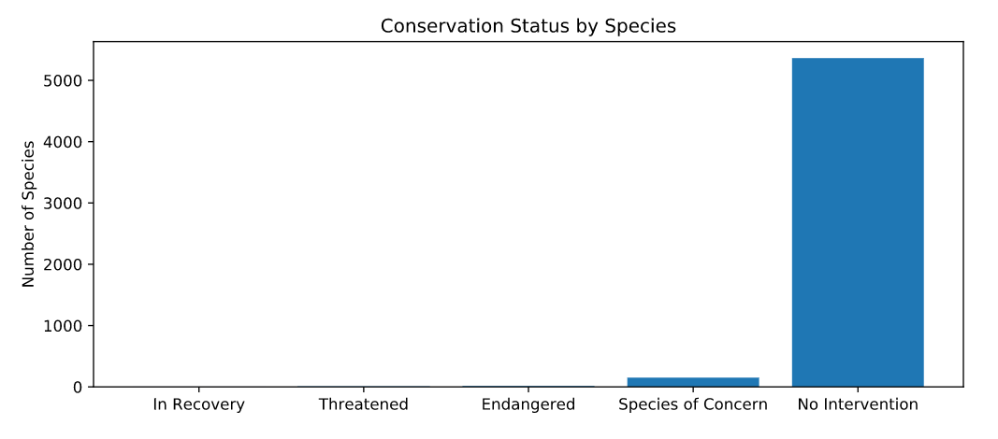
Graphs/Charts from Analysis

Slide 16
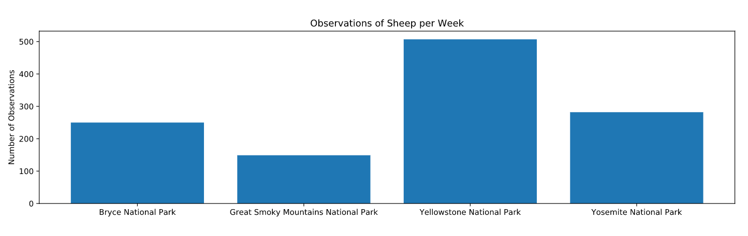
Graphs/Charts from Analysis

